Slide 1


Module 1
Getting Started and Important Information

Slide 2

Purpose of This Module
Get you acquainted with the course
Setup of your webspace and FTP
Look over the course carefully
Getting used to reading Announcements
Learn Basic HTML/CSS in Simulator

Slide 3
Patriots Pursuit – A tribute to Pat Tillman
This assignment is performed in the simulator
The link is: https://iftweb.eng.asu.edu/ift301/tutorials/
You use the same Username/Password combination as you did with the FTP
Don’t forget to create the folders in FTP! This is where the simulator checks for the files
Follow the tutorial very carefully
To view your work online, the URL will be:
https://iftweb.eng.asu.edu/[YOUR USERNAME]/www/[ANY SUB-FOLDER]/[THE FILENAME INCLUDING EXTENSION]

Slide 4

Expected Results
This is what your website should look like
When it is completed

Slide 5
Important Terminology and Definitions
HTML – Hyper Text Markup Language
CSS – Cascading Style Sheet
JavaScript – Programming Language commonly used with HTML
FTP – File Transfer Protocol – FTP is the method of transferring files from your desktop to the server
Download – Moving files from a server to your desktop
Upload – Moving files from a desktop to a server
HTML Tag - HTML tags are the keywords on a web page that define how your web browser must format and display your web page

Slide 6
Important HTML/CSS Tags for This Assignment
Folder – the virtual location for applications, documents, data or other sub-folders. You will use this often
Zip – Compressing file(s) to make them smaller, add many files into a file for portability. Uses the .zip extension
Unzip – Decompressing a file with a .zip extension
Element - An HTML element is defined by a start tag, some content, and an end tag (https://www.w3schools.com/html/html_elements.asp)

Slide 7
Important HTML/CSS Tags for This Assignment
Header element– The element represents a container for introductory content or a set of navigational links
Main element - specifies the main content of a document
Section element - defines a section in a document
Article element - specifies independent, self-contained content
Footer - defines a footer for a document or section

Slide 8
Important HTML/CSS Tags for This Assignment
Nav Element - defines a set of navigation links
Image Element (img)- used to embed an image in an HTML page
utf-8 (inicode) - Unicode is a universal character set that defines all the characters needed for writing the majority of living languages in use on computers
Hyperlink Syntax - The HTML <a> tag defines a hyperlink
Header Elements - The <h1> to <h6> tags are used to define HTML headings

Slide 9
HTML Lists
Ordered Lists – An ordered list is a group of items ordered by importance
Unordered Lists – An unordered list is a group of items in no particular order

Slide 10
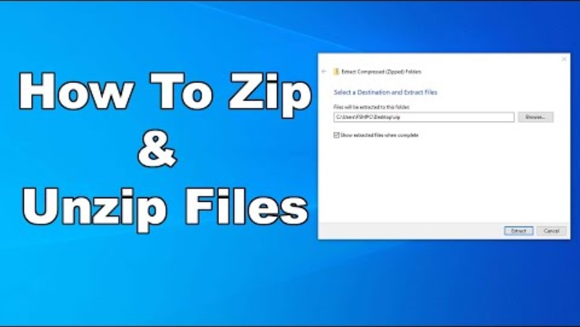
Zipping and Unzipping Files

Slide 11
Thank you!

